Slide 1
Coming Home: Reclaiming and Retaining Omega’s Sons A Plan of Action and Commitment
5th District Reclamation
Omega Psi Phi Fraternity, Inc.
Bro. Dennis “Biggie” Small, Chairman

Slide 2
Bringing Omega Men Home
Retention and Reclamation Overview
Strategies for Retaining and Reclaiming:
Omega University
Reclamation/Retention Workshop
Homecoming “Hit Teams”
Town Hall Meetings
Marketing Omega
Financial Benefits
Next Steps

Slide 3
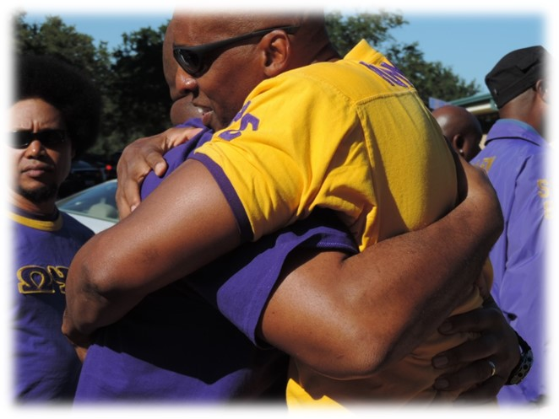
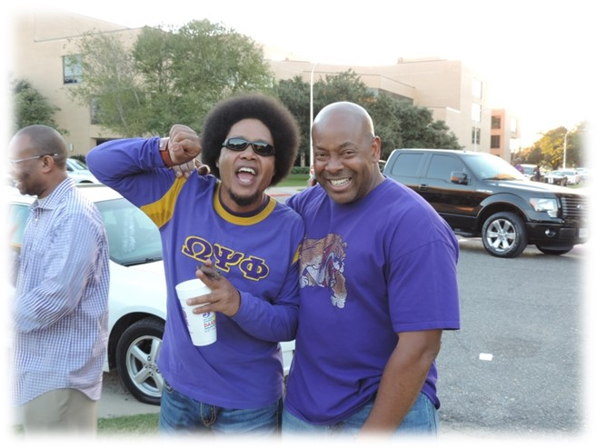
Reclaiming and Retaining
Re-acquainting
Re-introducing
Re-connecting
Re-committing
Re-igniting

Slide 5
Barriers to Reclaiming and Retaining
Brother-to-Brother conflicts over Fraternity business
Inability to forgive missteps, move on
Ineffective, podding meetings
Image of the Fraternity
Unwelcoming or parochial attitudes
Inadequate transition from undergraduate to graduate
Lack of role or niche to keep members engaged and involved
Perceived “slights” from having been out of touch with Omega

Slide 14
Plan B: Reclamation and Retention Workshop
5th D Agenda Template .doc
5th D Reclamation Agrmt .doc
5th D Standing Committees Sign-up Template.doc

Slide 15
Plan C: Homecoming “Hit” Teams

Slide 18
Town Hall Meetings

Slide 19
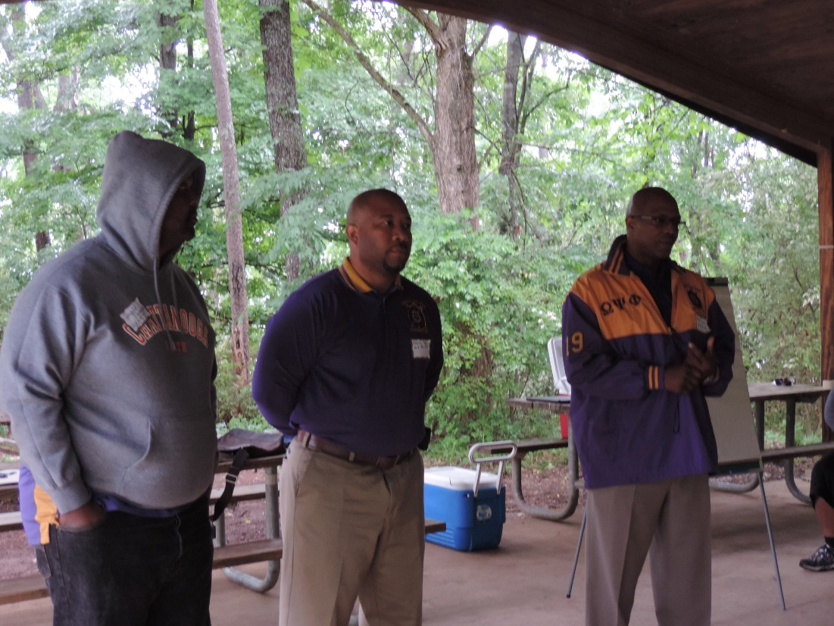
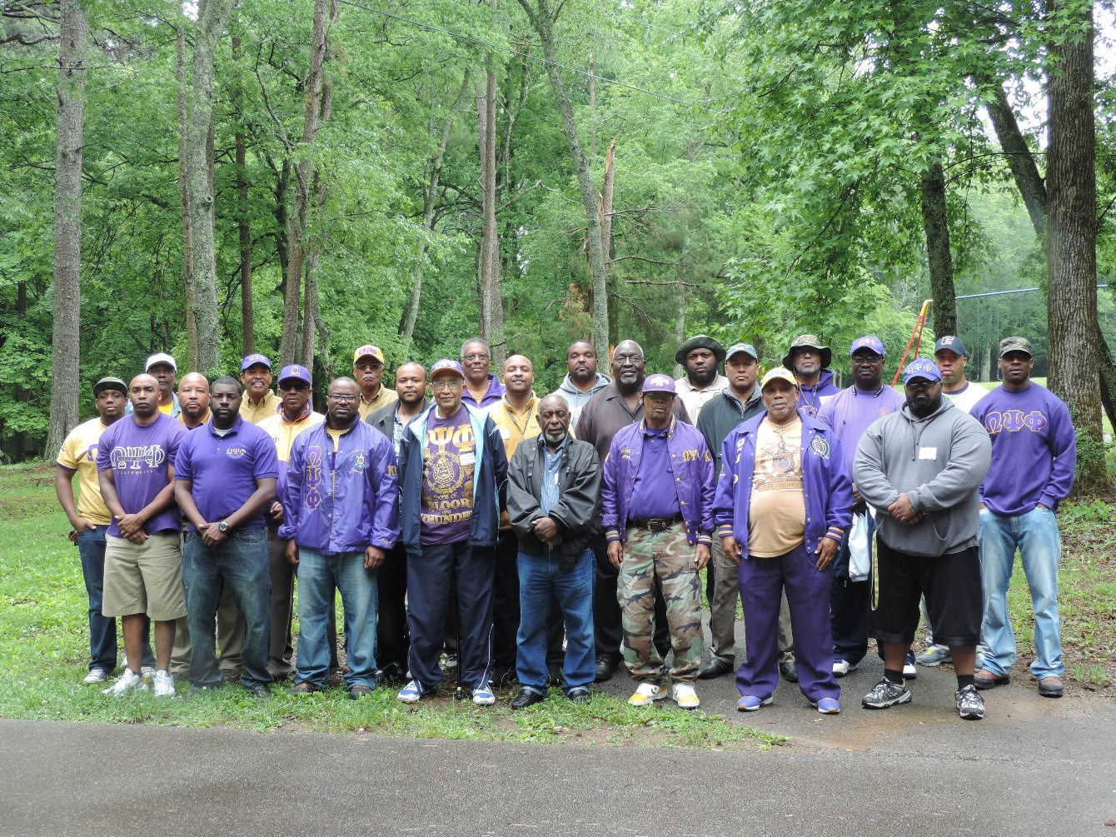
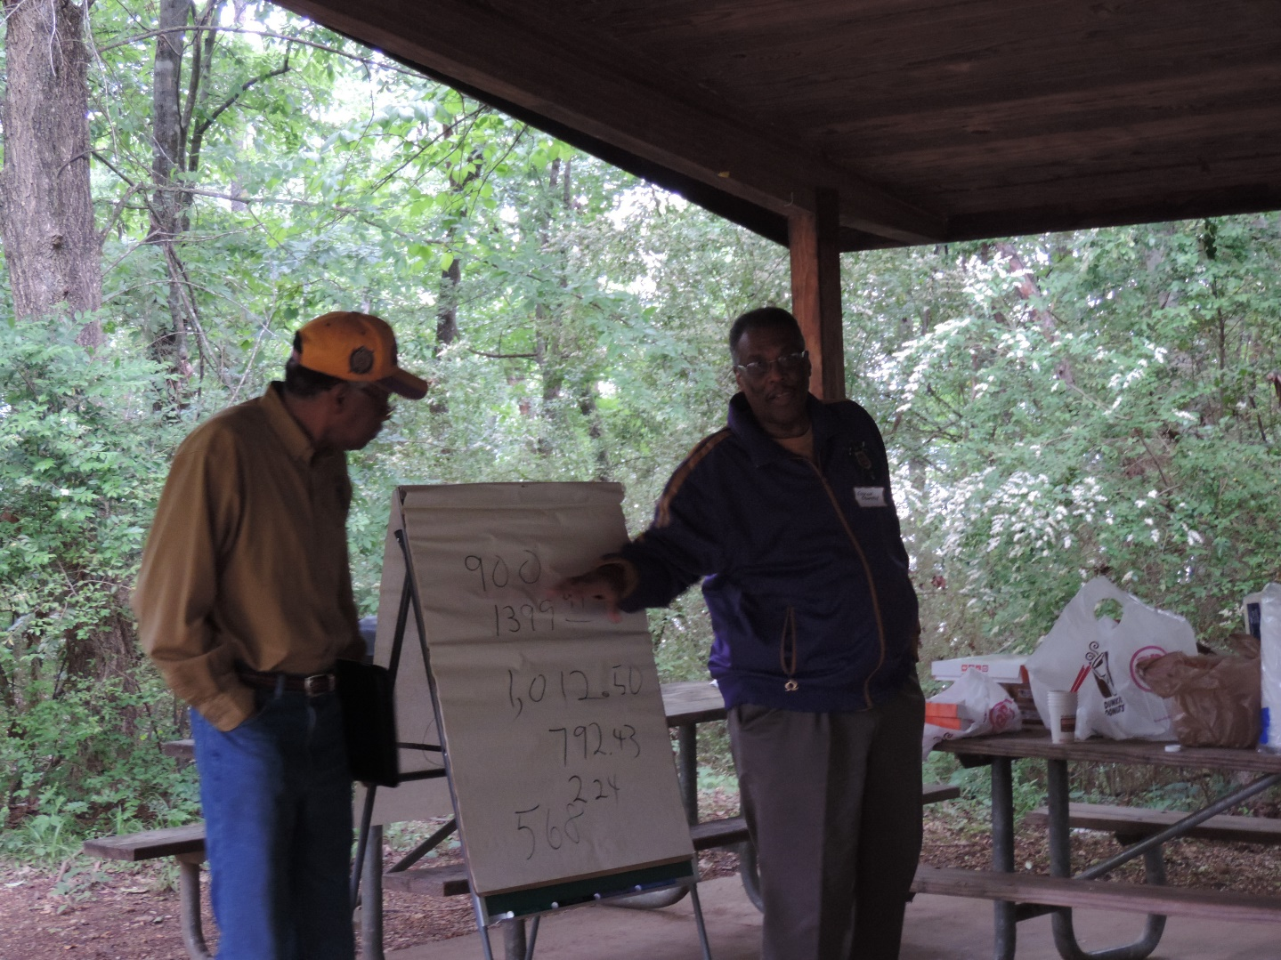

Slide 20
Contact Information
Dennis “Biggie” Small, Chairman
Fifth District Reclamation
Email: dsmall06@Hotmail.com
Phone: (901) 292-9032

