Slide 1
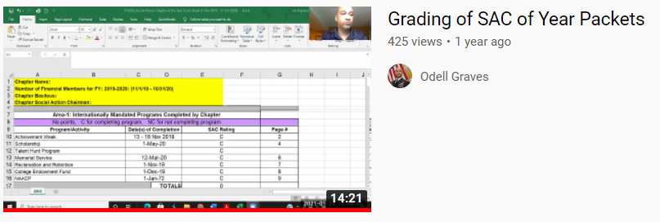
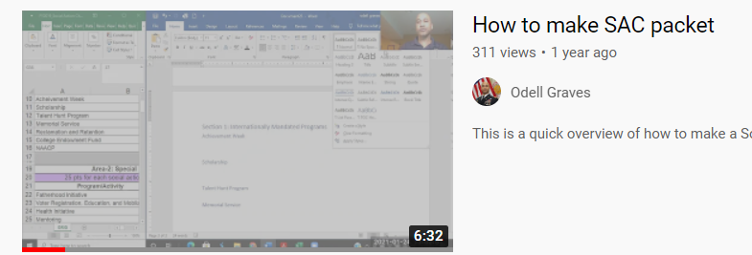
https://www.youtube.com/watch?v=91jD0u86htg
https://www.youtube.com/watch?v=DR1Pg9qJEro&t=38s

