Slide 1


KRS Training
Brother Sherman L. Charles, Grand Keeper of Records and Seal (GKRS)

Slide 2


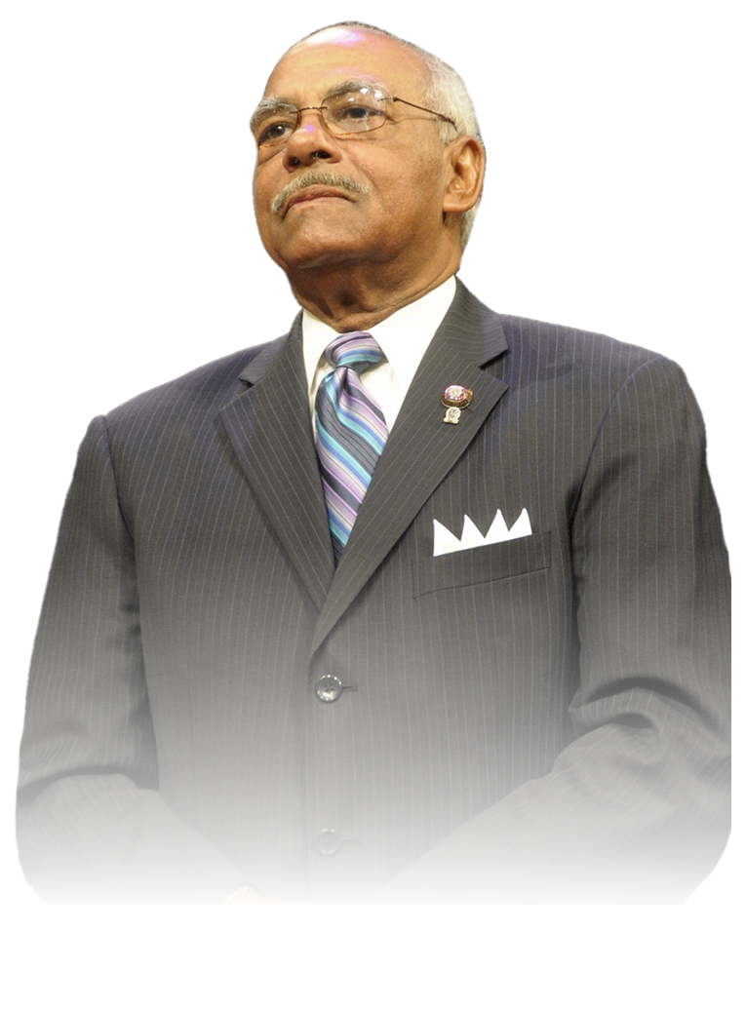
Purpose
This training session will provide a comprehensive overview of the roles and responsibilities of the Grand, District, and Chapter Keeper of Records and Seal (KRS).
Brothers will gain insight into key functions, common challenges, and best practices associated with the KRS position. By the end of the session, brothers will have a clearer understanding of how to effectively execute the duties of a Chapter KRS.

Slide 3
Agenda
KRS Core Responsibilities
  Grand Keeper of Records and Seal
  District Keeper of Records and Seal
  Chapter Keeper of Records and Seal
MSP -> Actions
  Approve Form 1
  Form 103A (Initiation Cover Letter)
Membership -> Actions
  Update Member Information
  Transfer Member
  Update Deceased Member
  Identify Graduated Members
Membership -> Reports
  Financial Members (Form 53)
  Member Dues Outstanding
  Member Roster
  Member Roster (At Large)
  MSP Certified Members
Chapter Info -> Actions
  Update Chapter Information
  Update Chapter Officers (Form 50)
  Submit Chapter Activities (Form 37)
  Submit Dues Payment
  Update Chapter Advisor
  Submit GPA Verification

Slide 4


Constitutional Duties of the KRS
(Grand and District)
Grand Keeper of Records and Seal (GKRS)
Administrative Oversight: Manages Fraternity’s official records and correspondence
Reporting Duties: Documents Grand Conclaves & Supreme Council proceedings; distributes reports within 90 days
Historical Stewardship: Maintains and archives the Fraternity’s history during tenure
Bereavement & Recognition: Issues condolences and published tributes in The Oracle
Financial Authorization: Signs disbursement orders; maintains property custody
District Keeper of Records and Seal (DKRS)
Meeting Documentation: Records and distributes District Meeting minutes
Operational Records: Establishes and maintains District records system
Financial Oversight: Reviews and co-signs fund disbursement requests
Training Compliance: Ensures required Fraternity training is conducted

Slide 5

Chapter KRS – Key Duties
Recordkeeping: Maintains Chapter minutes and charter documents.
Correspondence: Manages official Chapter communications.
Financial Role:
  Receives all funds; transfers to KF with documented receipts
  Signs and tracks disbursement order
Credentialing Support: Countersigns membership cards
Membership Records:
  Maintains member histories
  Updates IHQ/DKRS with Chapter changes
Bereavement Duties: Notifies GKRS/DKRS upon member death with obituary and biography
Public Relations: Manages local Chapter publicity

Slide 6

MSP -> Actions
Grand Keeper of Records and Seal (GKRS)
The MSP Section of QueZone
is where you will manage the
Requirements needed to obtain MSPU approval for your Chapter.
Key areas are:
Approve Form 1
Submit Form 103A (Initiation Cover Letter)
  Form 3
  Form 10

Slide 7

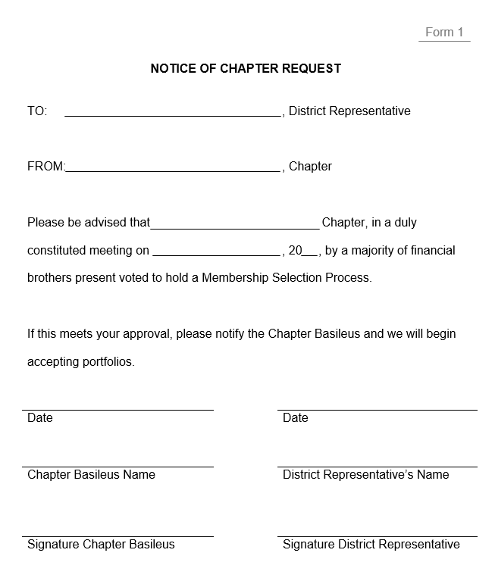
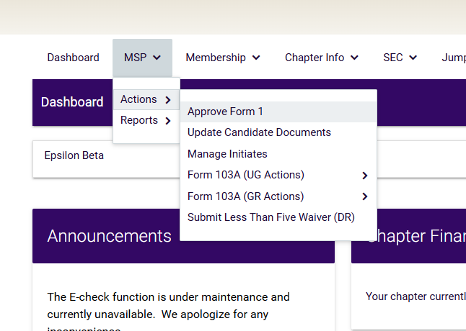
Approve Form 1
Notice of Chapter Request for MSPU

Slide 8
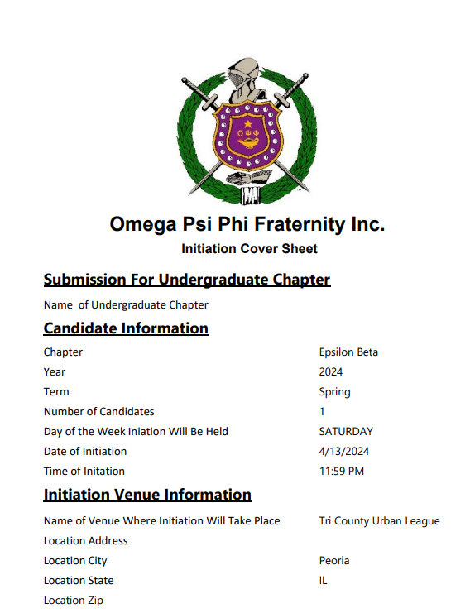
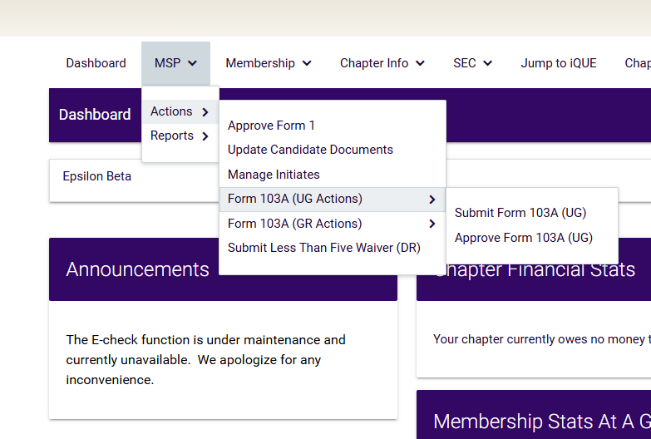
Form 103A
Initiation Cover Letter

Slide 9
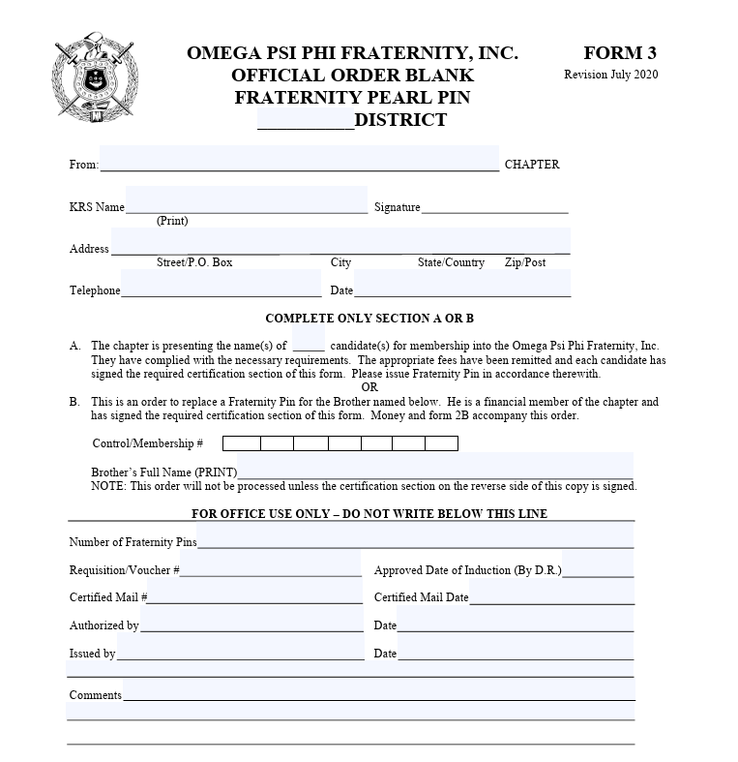
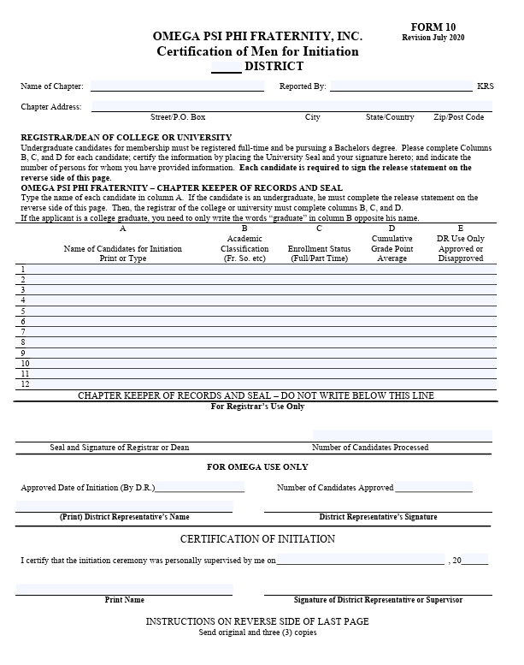
Form 103A Attachments
Form 3: Pin Order Form
Form 10: Certification of Men for Initiation

Slide 10
Membership -> Actions
Grand Keeper of Records and Seal (GKRS)
The Membership -> Action section of QueZone is your primary tool for managing and supporting the Brothers within your Chapter.
Key areas are:
Update Member Information
Transfer Member
Update Deceased Member (Omega Chapter)
Identify Graduated Members

Slide 11
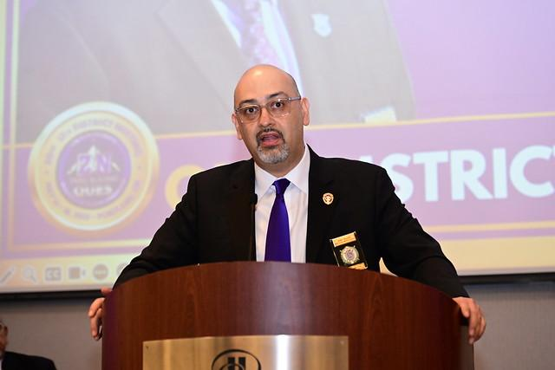
Update Member Information
Go to “Membership”
Go to “Actions”
Go to “Update Member Information”
Find Member and Select “Edit Profile”
Update all Contact Information (Phone Number, Email, and Home Address)
Select “Save”
Confidential. Internal use only. Distribution is strictly prohibited

Slide 12
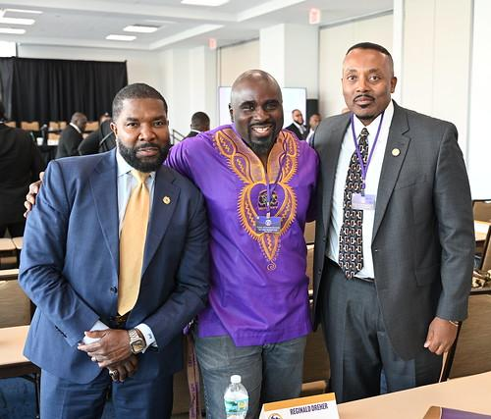
Transfer Members
Go to “Membership”
Go to “Actions”
Go to “Transfer Member”
Select “Continue”
Select “Add Member To List”
Provide Full Name, Control Number, and Current Chapter
Select “Search”
Select the Brother’s Name
Select “1” and “Continue”
Enter Your Name and Date, and Select “Continue” to Verify
Notes:
Note: You can also run a report of everyone that has transferred out of your chapter for the fiscal year. In QueZone, go to “Membership,” “then Reports,” scroll down to “Chapter Transfers,” and select.

Slide 13

Update Deceased Member
Go To “Membership”
Go To “Actions”
Go to “Update Deceased Member”
Select “Continue”
Select “1” for the Deceased Brother
Select “Continue”
Upload “Obituary or any Evidence“ and Include “Deceased Date”
Select “Continue”
Enter Your Name and Date, and Select “Continue” to Verify

Slide 14

Identify Graduated Members
Go to “Membership”
Go to “Actions”
Go to “Identify Graduate Members”
Select “Continue”
Select “1” for the Undergraduate Brother who has Graduate
Select “Continue”
Add the “Graduation Date”
Select “Continue”
Enter Your Name and Date, and Select “Continue” to Verify

Slide 15
Membership -> Reports
Grand Keeper of Records and Seal (GKRS)
The Membership -> Reports section of QueZone is where you will access and manage all required reports for your Chapter.
Key areas are:
Financial Members (Form 53)
Member Dues Outstanding
Member Roster
Member Roster (At Large)
MSP Certified Members

Slide 16

Financial Members (Form 53)
Go to “Membership”
Go to “Reports”
Go to “Financial Members”
Select “Export Drop Down Menu”
Select “Excel” and Save the File

Slide 17
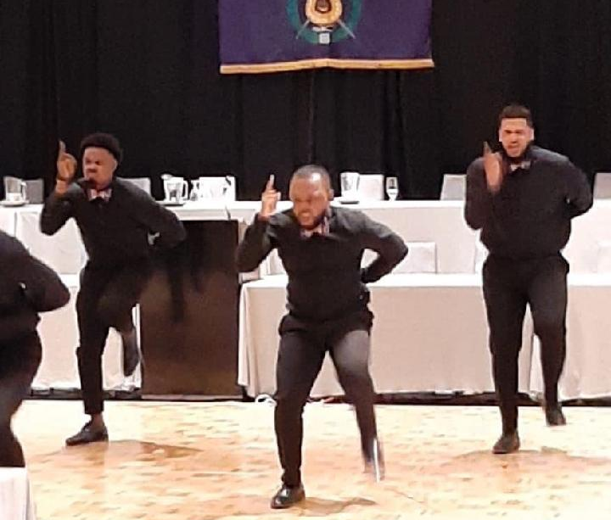
Member Dues Outstanding
Go to “Membership”
Go to “Reports”
Go to “Members Dues Outstanding”
Select “Export Drop Down Menu”
Select “Excel” and Save File

Slide 18
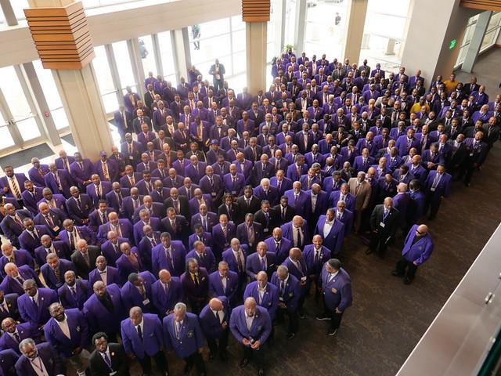
Member Roster
Go to “Membership”
Go to “Reports”
Go to “Members Roster”
Select “Export Drop Down Menu”
Select “Excel” and Save File

Slide 19

Member Roster (At Large)
Go to “Membership”
Go to “Reports”
Go to “Member Roster (At Large Members”
Select “Export Drop Down Menu”
Select “Excel” and Save File

Slide 20

MSP Certified Members
Go to “Membership”
Go To “Reports”
Go To “MSP Certified Members”
Select “Export Drop Down Menu”
Select “Excel” and Save File

Slide 21
Chapter Info -> Actions
Grand Keeper of Records and Seal (GKRS)
The Chapter Info -> Actions section of QueZone is where you will manage key administrative functions for your Chapter.
Key areas are:
Update Chapter Information
Update Chapter Officers (Form 50)
Submit Chapter Activity (Form 37)
Submit Dues Payment
Update Chapter Advisor
GPA Verification Action

Slide 22
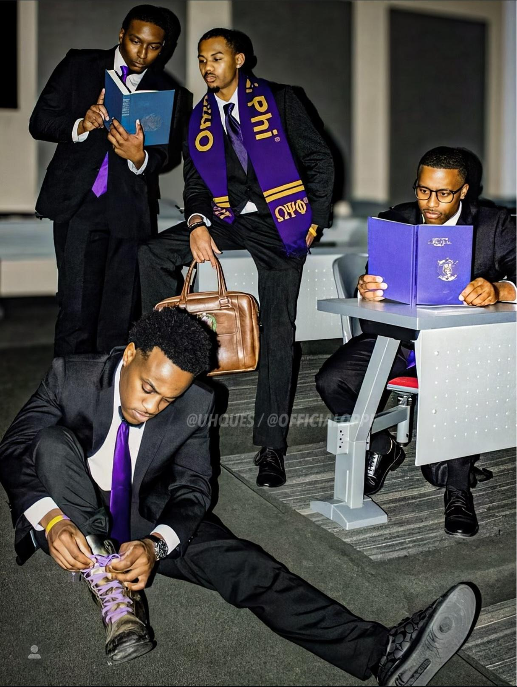
Update Chapter Information
Go to “Chapter Info”
Go to “Actions”
Go to “Update Chapter Information”
Enter The Chapter’s Correct Mailing Address, Email Address, Phone Number, and Website
Select “Save”

Slide 23
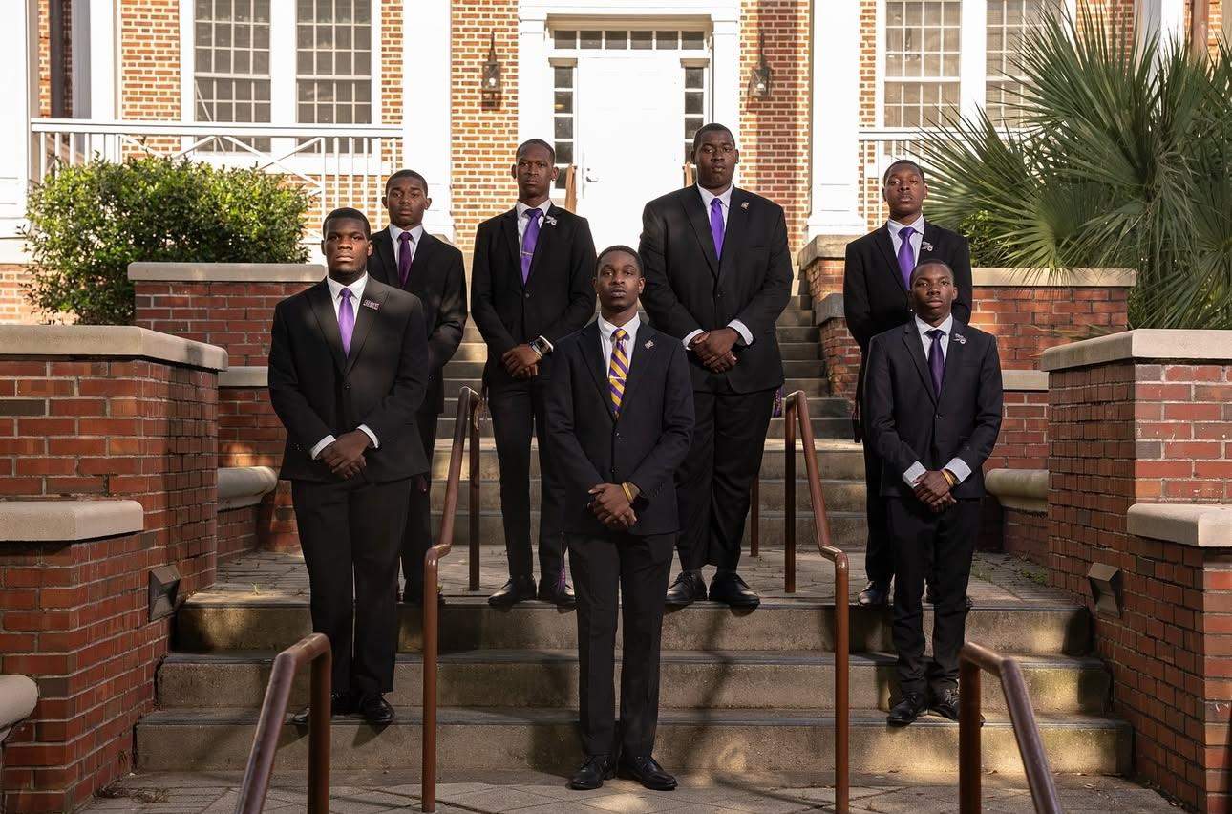
Update Chapter Officers (Form 50)
Go to “Chapter Info”
Go to “Actions”
Go to “Update Chapter Officers”
Select “Continue”
Select “Position(s)” That Need Updating
Select “Continue”
Select “Find a Member” and Input Full Name and Control #, and Select “Search”
Select the Brother, Enter Date, and Select “Continue”
Enter Your Name and Date, and Select “Continue” to Verify

Slide 24
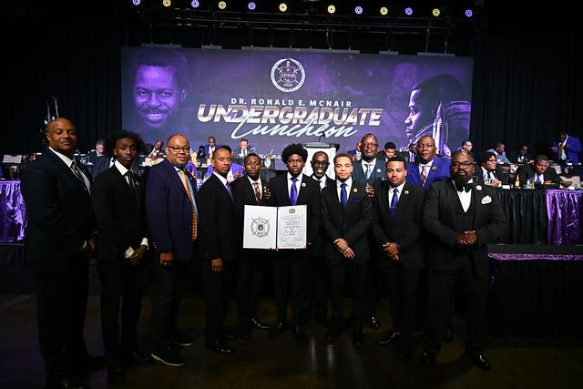
Submit Chapter Activity (Form 37)
Go to “Chapter Info”
Go to “Actions”
Go to “Submit Chapter Activity”
Select “Continue”
Check “Select”
Select “Continue”
Enter the Required Chapter Activity Information
Select “Continue”
Enter Your Name and Date, and Select “Continue” to Verify

Slide 25

Submit Current Year Dues Payment
Go To “Chapter Info”
Go To “Actions”
Go To “Submit Current Year Dues Payment”
Select “Continue”
Select the Brother(s) you would like to pay Dues (they will not show if Brother is At Large)
Select “Continue”
Provide the Chapter’s Credit/Debit Card Information and Select “Continue”
Enter Your Name and Date, and Select “Continue” to Verify

Slide 26
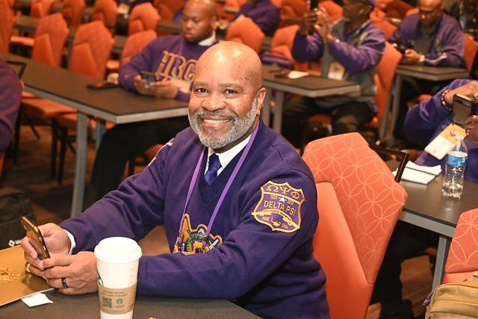
Update Chapter Advisor
Go to “Chapter Info”
Go to “Actions”
Go to “Update Chapter Advisor”
Select “Continue”
Check “Select”
Select “Continue”
Select “Find a Member” and Input Full Name and Control #, and Select “Search”
Select the Brother, Enter Date, and Select “Continue”
Enter Your Name and Date, and Select “Continue” to Verify

Slide 27
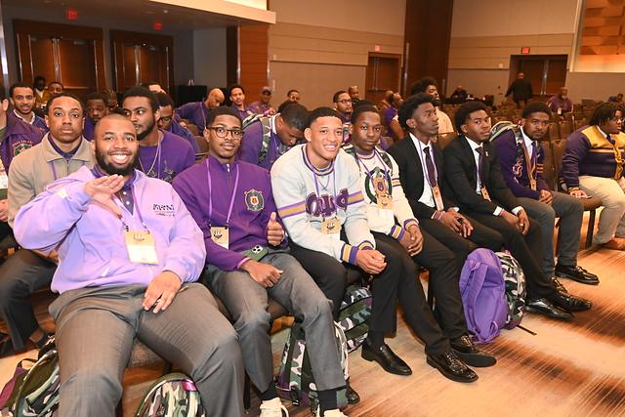
GPA Verification Action
Go to “Chapter Info”
Go to “Actions”
Go To “GPA Verification Actions”
Go to “Submit Chapter GPA Verification”
Select “Continue”
Check “Select” for Year/Term
Select “Continue”
Upload “GPA Verification Form“
Select “Continue”
Enter Your Name and Date, and Select “Continue” to Verify

Slide 28

QUESTIONS?

